Slide 1

VAULTSOFCODE TASK - 2
CONTENT: Functions , modules and Data Manipulations

Slide 2
Table of contents
01
02
03
04
05
06
Overview
Functions
Modules
Data Manipulation
Importance
Conclusion

Slide 3

OverView
01
Functions:
- Python functions are reusable code blocks for specific tasks.
- Defined with `def`, take parameters, and can return values.
- Key for code organization and reusability.
Modules:
- Modules are Python files with code, functions, classes, and variables.
- Imported with `import`, allowing code reuse.
- Python's standard library provides numerous modules.
Data Manipulation:
- Involves cleaning, transforming, filtering, and analyzing data.
- Libraries like NumPy and pandas are essential.
- Prepares data for analysis, visualization, and modeling.

Slide 4
02
FUNCTIONS IN PYTHON

Slide 5
Functions
A function is a block of reusable code that performs a specific task or set of tasks. Functions allow you to break your program into smaller, more manageable pieces, making your code more organized and easier.
def keyword is used to define a function.
function_name is the name of the function.
parameters are optional input values that the function can take.
The colon : indicates the start of the function block.
The function block is indented and contains the code to be executed.
return statement is used to specify the value that the function should return.
If no return statement is provided, the function returns None by default.
__________________

Slide 6
03
MODULES IN PYTHON

Slide 7
MODULES
Modules are files containing Python code that can be reused in other scripts.
Python has a rich standard library of modules for various purposes, such as math, os, and random.
You can create your own modules by organizing related functions, classes, or variables in a Python file.
To use a module, you need to import it using the import statement.
You can import specific functions or classes from a module using the from keyword.
Modules help organize and encapsulate code, making it more modular and maintainable.
Reusing code from modules reduces redundancy and makes your code more efficient.
Custom modules can be shared and reused in multiple Python scripts.
_________________________________

Slide 8
Examples:
Functions :
Explanation:
Program
# defining a function
def rec_area(len, wid):
area = len * wid
return area
#calling the function
len =5.0
wid = 3.0
result = rec_area(len ,wid)
print( f" The area is {result}.")
def rec_area(len,wid) | Defines function name with parameter 'len' and 'wid' .
area = len*wid | Formula to find rectangle area and storing the value inside the variable ' area '.
return area | The return statement specifies the value that the function will return. In this case, it returns the calculated area.
__________________________________

Slide 9
Examples:
Module :
Explanation:
Program
import shape_calculator
# Calculate the area of a circle with a radius of 5 units
circle_area = shape_calculator.cir_area(5)
print("Circle Area:", circle_area)
shape_calculator | Importing the module ‘shape calculator ‘
cir_area | Functions from the module to calculate area of circle.
import | Used to install the package and libraries
__________________________________

Slide 10
Data Mananipulation
04
________
______________
___________
______________________
_________________________

Slide 11

DATA MANIPULATION IN PYTHON
Data manipulation in Python involves various operations on data, such as cleaning, transforming, filtering, and analyzing data to extract useful information. Python provides several libraries and tools for data manipulation.

Slide 12

1. DATA STRUCTURES 2.NUMPY 3.PANDAS 4.DATA CLEANING 5.DATA TRANSFORMATION 6.DATA FILTERING 7.DATA VISUALIZATION 8.DATA ANALYSIS 9.STRING MANIPULATION 10.DATETIME OPERATIONS 11.ITERTOOLS 12.LIST COMPREHENSIONS
TOPICS COVERED

Slide 13
1. DATA STRUCTURES: Python provides built-in data structures like lists, tuples, dictionaries, and sets for holding and organizing data. 2. Libraries like NumPy and pandas offer specialized data structures for numerical and tabular data. 2. NUMPY: 1. A library for numerical operations in Python, NumPy provides arrays and matrices for efficient numerical computations. 2. It supports element-wise operations, mathematical functions, and advanced indexing. 3. PANDAS: 1. pandas is a data manipulation library that introduces DataFrames, tabular data structures similar to spreadsheets. 2. It offers versatile tools for data cleaning, transformation, filtering, and analysis.

Slide 14
4. DATA CLEANING: 1. Data cleaning involves handling missing values, duplicates, and outliers in the dataset. 2. Techniques include dropping or filling missing values, removing duplicates, and detecting and dealing with outliers. 5. DATA TRANSFORMATION: 1. Transformations like sorting, reshaping, and aggregation help prepare data for analysis. 2. pandas provides functions for sorting, pivoting, and aggregating data using groupby() and agg(). 6. DATA FILTERING: Filtering extracts subsets of data that meet specific conditions. pandas supports boolean indexing to filter DataFrames based on column values.

Slide 15
7. DATA VISUALIZATION: Matplotlib and Seaborn are popular libraries for creating data visualizations, such as charts, histograms, and scatter plots. 8. DATA ANALYSIS: 1. Libraries like Scipy, Statsmodels, and scikit-learn are used for statistical analysis and machine learning tasks. 2. They offer functions for hypothesis testing, regression analysis, and machine learning model building. 9. STRING MANIPULATION: Python provides string manipulation techniques, including regular expressions, string formatting, and text parsing.

Slide 16
10. DATETIME OPERATIONS: Working with dates and times is crucial; Python's datetime module assists in parsing, formatting, and performing operations on dates and times. 11. ITERTOOLS: The itertools module provides tools for working with iterators, enabling advanced iteration and combination operations. 12. LIST COMPREHENSIONS: List comprehensions are concise methods for creating lists or applying operations to existing lists.

Slide 17

IMPORTANCE
CONSISTENCY
USABILITY
CLEANSING
It maintains consistency across data accumulated
It allows users to cleanse and organize data
It helps clear unwanted data

Slide 18

CONCLUSION
Functions in Python allow code reuse and organization.
Modules are reusable code files.
Data manipulation in Python involves cleaning, transforming, and analyzing data, facilitated by libraries like NumPy and pandas.

Slide 19
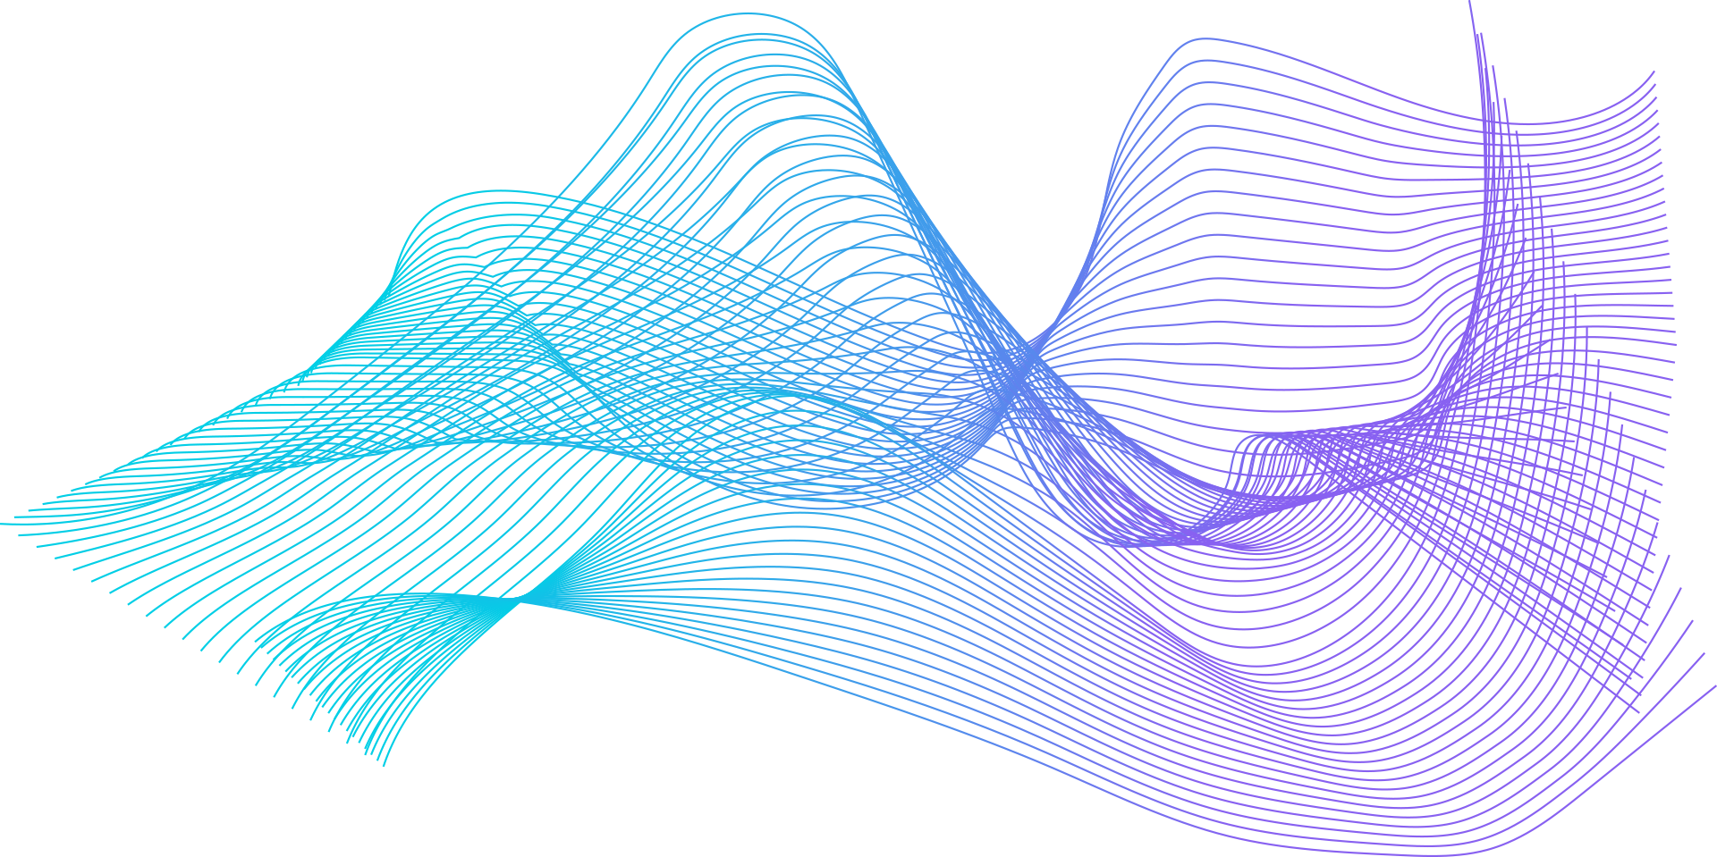


Thanks!
Do you have any questions?
Mohan Sai Teja
k.mohansaiteja112233@gmail.com
+91 93925 2****

